Slide 1
MULTI DIMENSIONAL NEURAL NETWORK
A neural network architecture
Notes:
Introductory chat and than transition into: Multidimensional neural network, which is a neural network architecture. Multidimensional neural network is a research project whose goal is to discover a new type of neural net architecture and aims to contribute in machine learning society. Further on MDNN will be get discussed in upcoming slides.

Slide 2

PROJECT-II
Department of Computer Science & Engineering
Faculty of Engineering
MEDI-CAPS UNIVERSITY, INDORE- 453331
FEB 2022
Notes:
MDNN is research based project undergoing in Medi-Caps university under computer science and engineering department for the fulfilment of B. Tech degree.

Slide 3
Submitted To
Prof. Prasanna Kapse
Submitted By
EN18CS301289 Venish Patidar
EN19CS3T1004 Raj Gupta
EN18CS301294 Yash Biyani
Notes:
It will be submitted to
It will be submitted by

Slide 4
CONTENTS OF THIS PRESENTATION
INTRODUCTION
OBJECTIVE
TECHNOLOGY USED
LITERATURE REVIEW
METHODOLOGY
RESULTS
CONCLUSION
Notes:
Flow of this presentation will be as shown on screen.

Slide 5
SHORT BREIFING OF CONTENTS
01
02
03
+ Introduction
+ Objective
+ Technology used
04
05
06
+ Literature review
+ Methodology
+ Results and conclusion
This section will give a gentle introduction to MDL
The main focus and objective of the MDL research.
Technologies that we have accompanied to achieve MDL
Review of previously published works that is linked to MDL
How we had implemented MDL?
The benchmarks and other conclusions drawn from research
Notes:
In the introductory section we will have a gentle introduction to the MDL. After having an overview understanding of MDL, we will be transiting into the objective of MDL and bring our main focus to it.
Then we will discuss the required technologies that will be essential in implementation of MDLs. Moving further to Literature review, which would be essential as because study of work that has been done in conventional neural network is highly essential in implementation of MDLs. After putting all tools together and knowledge to use them we will discuss how to use them in methodology section. Finally in result and conclusion we will share the taste of our ripped fruit with some benchmarks.

Slide 6
01
INTRODUCTION
ABOUT THE PROJECT

Slide 7
INTRODUCTION
The end points of neural network field is still unknown and it’s by the time today expanding. As due the fact of its vast research area, there are lots of different type of neural network architecture. All varying from a single neuron which is perceptron, all the way to RNNs (recurrent neural networks). Some are feedforward neural nets others are feedback compatible as well. However, most of these neural network architectures have multiple hidden layers, comprises in itself, there isn’t any dimensionality feature to these hidden layers, i.e., multiple layers stacked-on-each-other (metaphorically) to make a single hidden layer, as to be called Multidimensional neural network. The Multidimensional neural network is research project work which aims to explore the area of neural network architecture. The proposed architecture will make the existing network more flexible and introduce new dimensionality parameter to it, particularly to hidden layers. It does so by introducing a whole complete new hidden layer in another dimension to a particular layer. Introduction to the new hidden layer in another dimension increases parameters and complexity, however, as it stands now, the accuracy and loss will be explored further.

Slide 8
CONVENTIONAL NEURAL NETWORK
Dense layer_3
Dense layer_2
Dense layer_1
Dense layer_4
Dense layer_5
Notice that at differenet level of network they all are sequential i.e., at any level receiving layer have only one dense layer.

Slide 9
WHAT WE ARE WORKING ON
MDL
MDL+DL
MDL+MDL
Adding dimensioality funtionality to a current dense layer, by doing that it will have multiple dense layer side by side receiving same input.
Making multidimensional dense layer compatible to be mapped with conventional dense layer
Making multidimensional dense layer compatible to be mapped with another multidimensional dense layer

Slide 10
MULTIDIMENSIONAL NEURAL NETWORK
After introducing the multidimensional dense layer to any conventional neural network it will be multidimensional neural network, comprising of one or more than one MDL along with DL or all MDL as well.

Slide 11
COMPLEXITY PERCENTAGES
20%
40%
DL + DL
DL + MDL
60%
80%
MDL+ DL+MDL
MDL+MDL
Implementation of dense layer with dense layer is conventional.
Since, there are more than one layer in MDL to receive input from same DL complexity increases
As middle DL need to recive and pass the information from MDL to MDL, its implemention is more complex
As the information will get transsfered from MDLs to MDLs, its on of most complex part of project
*this percentage are tentative and the base comparer is the perceptron

Slide 12
02
OBJECTIVE
FOCUS POINT OF THE PROJECT

Slide 13
OUR OBJECTIVES
+ Accuracy
+ Implementation
The implemented MDL must have accurate calculations and mathematical operations
Desginig and implementing MDL
+ Compatibility
+ Flexibility
MDL must be compatible with conventional Dense layers
MDL should have flexibility of having one or multiple dimension and not limited to two dimensions.

Slide 14
03
TECHNOLOGY USED
BUILDING TOOLS OF THE PROJECT

Slide 15
BASIC REQUIREMENTS
+ Developing machine
+ Idle
A computer machine with having more than 16 gigs or memory, latest in decade windows os is preffered as future of this MDNN is to implement it in Unreal engine.
Visual studio code is used while developing the project, however, it’s not essential to use this particular idle, any other idle could be used as well.

Slide 16


TECHNOLOGIES USED
C++
Armadillo
The MDNN is having c++ at its core. Whole architecture is implemented in c++, from feedforward to calculating loss functions and implementing optimizers.
Armadillo is a high quality linear algebra library (matrix maths) for the C++ language, aiming towards a good balance between speed and ease of use.

Slide 17
WHY C++ ? WHY NOT PYTHON FOR NEURAL NETWORK?

Slide 18

REASONS TO USE C++
+ Speed
+ UE4
+ Challenge
As C++ is compiled language. It excutes much faster than python
As future of this project is to integrate MDNN in UE4 for visualization, since UE4 is only c++ compatible hence we chose c++ as developing language.
As almost all of machine learning programs are being implmented in python these days which encourage us to use c++ as challeng.

Slide 19
04
LITERATURE REVIEW
DOING THE HOMEWORK

Slide 20
Loss Functions or Cost Functions
In mathematical optimization and decision theory, a loss function or cost function (sometimes also called an error function) is a function that maps an event or values of one or more variables onto a real number intuitively representing some "cost" associated with the event. Some of cost functions are Binary cross entropy, categorical cross entropy, SoftMax and more. Mostly we will be using BCE in MDNN. Binary cross entropy mathematically is defined as
$$J\left(y,\hat{y}\right)= −\frac{1}{n}\sum_{i=1}^{n}{\left(y.\log{\hat{y}}+\left(1−y\right).log\left(1−\hat{y}\right)\right)}$$

Slide 21
Optimizers
While training the deep learning model, we need to modify each epoch’s weights and minimize the loss function. An optimizer is a function or an algorithm that modifies the attributes of the neural network, such as weights and learning rate. Thus, it helps in reducing the overall loss and improve the accuracy [12]. The most common optimizers are Gradient Descent, Stochastic Gradient Descent, Adam, RMSProp and others. For our testing purposes we had used Stochastic Gradient Descent which mathematically defined as:
$$W_next=W_curr-η ΔW$$

Slide 22
Partial derivatives
In mathematics, a partial derivative of a function of several variables is its derivative with respect to one of those variables, with the others held constant (as opposed to the total derivative, in which all variables are allowed to vary). Partial derivatives are used in vector calculus and differential geometry.
The partial derivative of a function f(x,y…) with respect to the variable x is variously denoted by:
$${f′}_{x} , ∂_{x}f, \frac{∂}{∂x}f , or \frac{∂f}{∂x}$$

Slide 23
05
METHODOLOGY
HOW?

Slide 24
METHODOLOGY
MDNN designed in such a way that it is compatible with conventional neural networks as well. It has classic class-object design which is simple yet very effective and robust. The MDNN is implemented in C++ language with Armadillo the only required library. Armadillo is a high-quality linear algebra library (matrix maths) for the C++ language, aiming towards a good balance between speed and ease of use. The whole program is compiled and packaged using GNU compiler version 11.2.0. The source program consists of the class named MDNN. This MDNN class is responsible for creating an object, this object is then used to create the different neural.

Slide 25
CLASS HIERARCHY OF MDNN
MDNN
ActivationsClass
LossesClass
OptimizersClass
AccuracyClass
ActivationsFunction
LossesFunction
OPtimizerFunction
Accuracy

Slide 26
06
RESULTS
PROOF FOR THE BEST

Slide 27
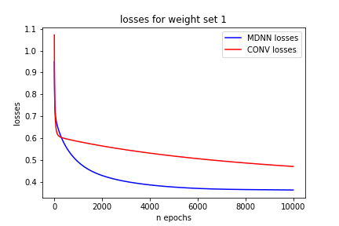
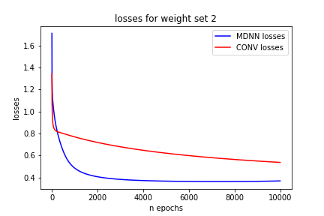
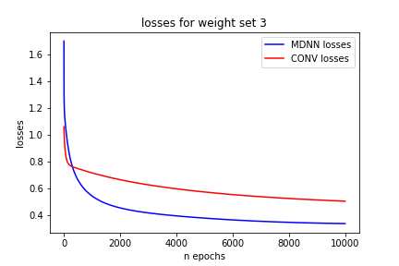
LOSSESE
Losses:
Weight set 1
Weight set 2
Weight set 3

Slide 28
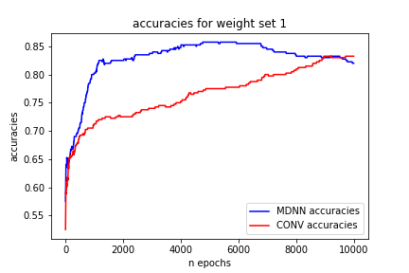
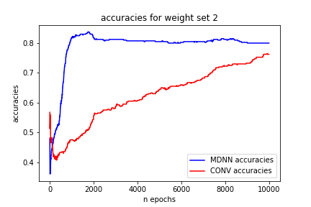
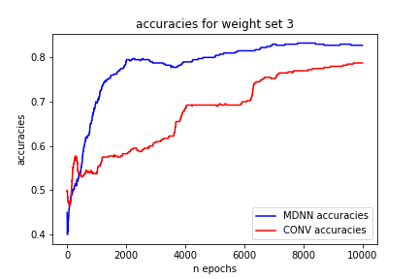
ACCURACIES
Losses:
Weight set 1
Weight set 2
Weight set 3

Slide 29
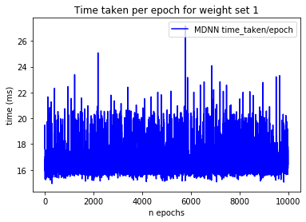
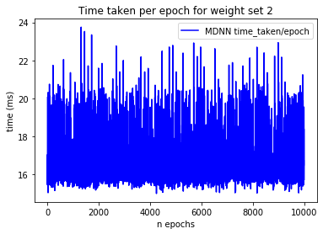
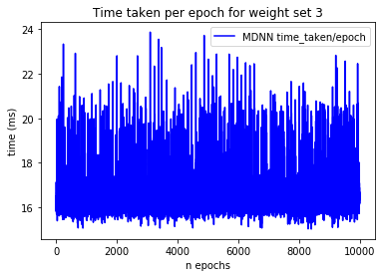
Time taken per epoch (MDNN)
Losses:
Weight set 1
Weight set 2
Weight set 3

Slide 30
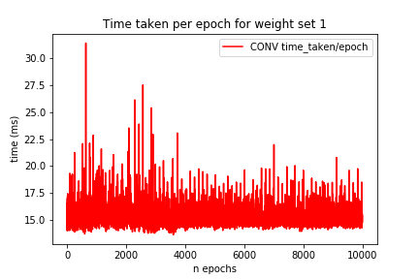
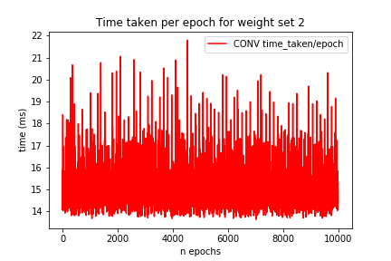
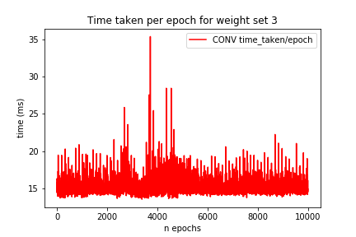
Time taken per epoch (CONV)
Losses:
Weight set 1
Weight set 2
Weight set 3

Slide 31
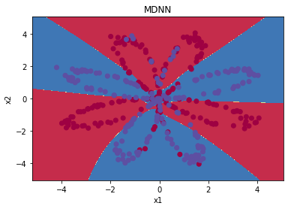
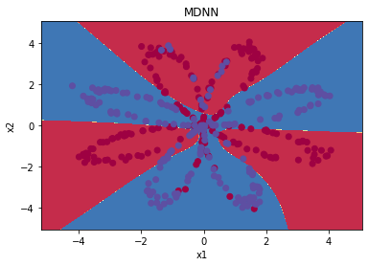
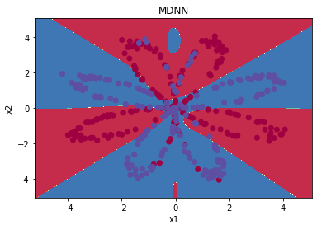
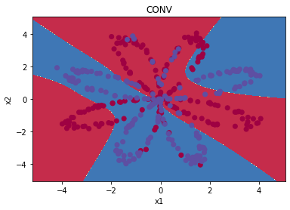
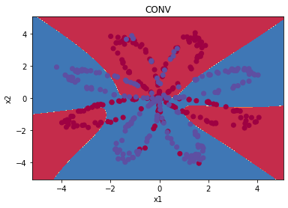
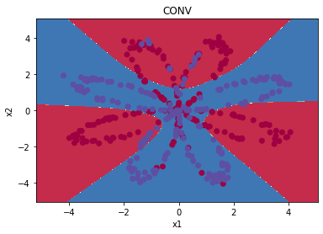
Decision boundary
Losses:
Weight set 1
Weight set 2
Weight set 3
MDNN
CONV

Slide 32
07
CONCLUSION
ITS CONCLUSION TIME

Slide 33
CONCLUSION
As due to the introduction of multi-dimensional layers, allows us in having different activation functions at same level. The use of multiple activation function in MDNN results in better loss convergence and achieving accuracies much faster than conventional neural network. By using the proper combination of activation function to use in pairs it would further boost the performance of MDNN. Although, it was thought that the introduction of new dimensionality feature would cost the computational time but the results were otherwise, the computation time was exactly similar to its counter conventional neural network provided both have same number of neurons at any particular layer. Which further shows that MDNN are superior than conventional neural networks.
We have shown that by the use of MDNN, any neural network would boost its performance. As MDNN allows the creator a flexibility of the dimensionality parameter as we talked earlier. This could be used to introduce multi-activated dense layer in conventional neural networks meantime without compromising the cost of computational timings. Our future work includes of introducing the interconnectivity between the dimensions of multi-dimensional layer i.e., a dense mapping between the dimensions of having different activation functions and calculating its gradients and optimizing it appropriately.

Slide 34
THANK YOU !

